Slide 1
Spyware
Konstantin Vetrov
Computer Science Department
Voronezh State University

Slide 2
Types of spyware
Spyware spread methods
Antispyware techniques

Slide 3

Adware

Slide 4
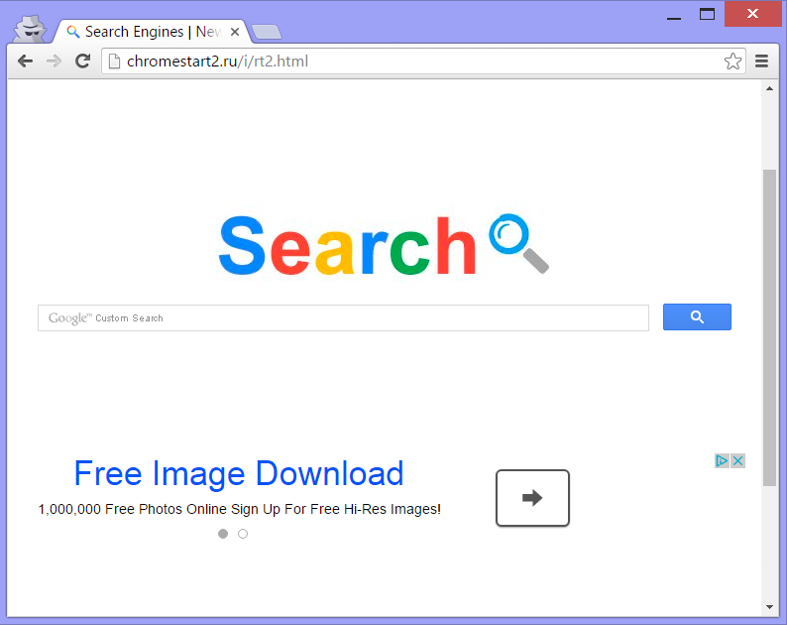
Browser Hijackers

Slide 5

Key Loggers

Slide 6
Spread Methods
Shareware software
Useful software
Drive by download
Fake antispyware

Slide 7
Antispyware techniques
Manual identification
Signature based identification
Behavior based identification

Slide 8
Spread Methods
Anti
spyware
Types
Adware
Browser Hijackers
Key Loggers
Shareware software
Useful software
Drive by download
Fake antispyware
Manual identification
Signature based identification
Behavior based identification

Slide 9
Spyware
Konstantin Vetrov
Computer Science Department
Voronezh State University
Email – phluoro@gmail.com

